Slide 1


Video Games Sales Dashboard Insights
Purpose of The Project :
Analyzing Key Metric Trends within Gaming Industry
Presented by : Abdalla Akal

Slide 2
PROJECT DESCRIPTION
The goal of given project was to analyze video game sales across different regions, genres, platforms, publishers and time periods.
The data was clean and transformed using Excel and Power Query before being analyzed in Power BI.
After analyzing the data, an interactive dashboard with KPI cards, charts, slicers, and filters were built with Power BI

Slide 3
OVERVIEW
Dataset contained more than 16,000 video game sales records.
Records included games released across multiple platforms and time periods.
Key metrics tracked:
Platforms
Genres
Publishers
Region Sales – Divided into North America, Europe, Japan, and other markets.

Slide 4
RESEARCH QUESTIONS
Which video game genres generated the highest global sales?
Which platforms and publishers performed best overall?
How did global video game sales change across different time periods?
How did genre performance differ across North America, Europe, Japan, and other regions?
Which platform and genre combinations showed the strongest sales performance?

Slide 5
DATA CLEANING/PREPARATION
The dataset was in an Excel file format and loaded into Power Bi
Removed the “Global Sales” column to avoid duplicate totals after restructuring the data.
Unpivoted the NA Sales, EU Sales, JP Sales and Other Sales column into separate Region and Sales Columns.
Region column was cleaned by removing underscores from category names.
Filtered out records where the value was listed as “N/A”
Grouped the year data into decades to make sales trend easier to compare and visualize.

Slide 6
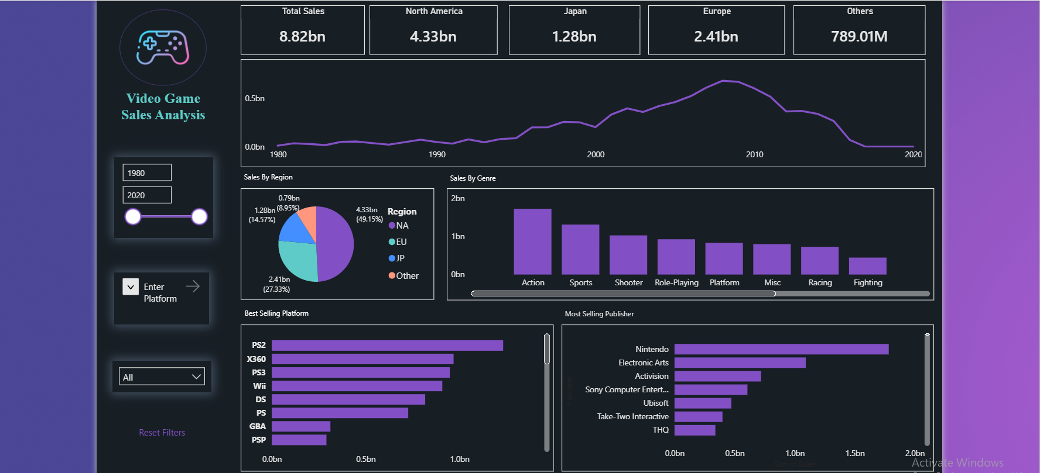
DASHBOARD

Slide 7
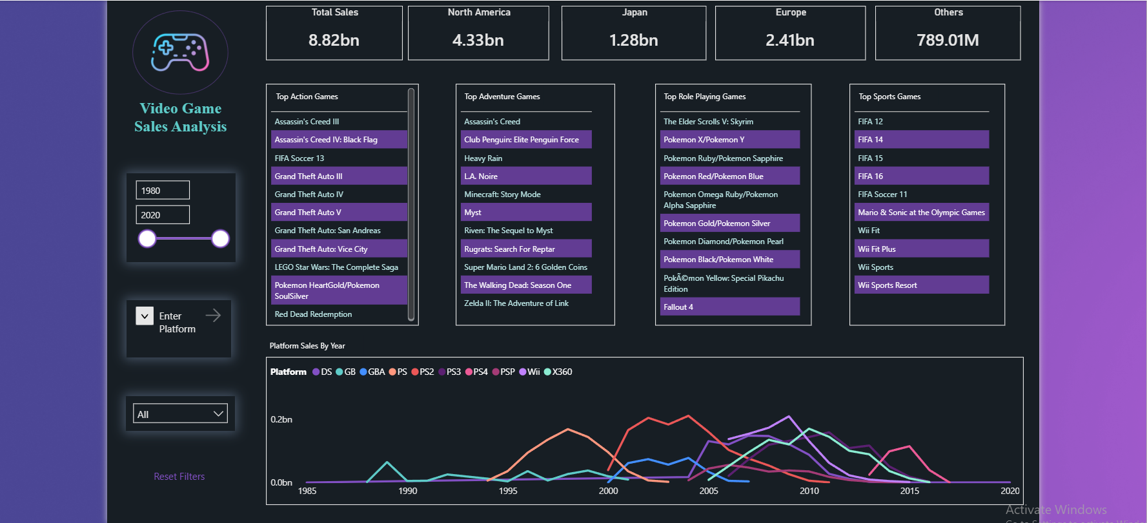
DETAILED DASHBOARD

Slide 8
INSIGHTS

Slide 9
KEY FINDINGS BY GENRE
#1 Action
Action games led all video game genres in global sales. North America dominated with roughly half of all Action game purchases, while Europe followed with 30%. The remaining share was split between other markets at 10.74% and Japan at 9.21%.
The top-selling game within the Action genre was Assassin's Creed 3, with 6.2 million units sold in North America alone and total global sales of 13.10 million units.
Action game sales peaked in 2012, with the PS3 leading all platforms at 6.5 million units sold.
#2 Sports
Globally, Sports games finished second in genre sales behind Action. North America accounted for the largest share at 670.09 million units, with Europe contributing 371.34 million, Japan 134.76 million, and other markets 132.65 million units sold.
Within the Sports genre, FIFA 12 topped sales performance, with Europe accounting for the highest regional sales at 8.5 million units. The PS3 led all platforms at 6.69 million units sold.

Slide 10


Top-Performing Games Across Action & Sports Genres by Platform
#1 Action
#2 Sports

Slide 11
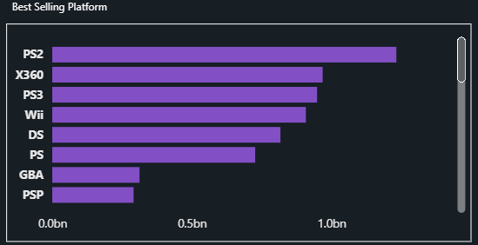
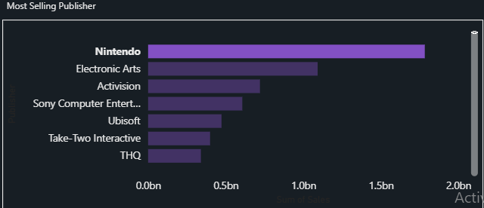
PLATFORM AND PUBLISHER FINDINGS
Among all platforms, the PlayStation 2 dominated total sales at approximately 1,233.46 million units. Close behind, the Xbox 360 claimed second place with 969.61 million units, followed by the PlayStation 3 at 949.35 million units sold.
Nintendo led all publishers with 1,784.43 million units sold, ahead of Electronic Arts at 1,093.39 million and Activision at 721.41 million units. While Sony held dominance in platform sales, Nintendo's publisher performance stood in a league of its own.

Slide 12

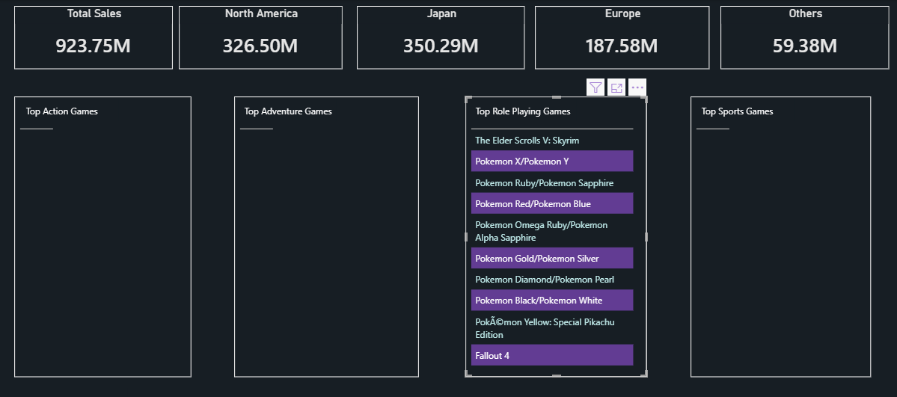
REGIONAL SALES FINDINGS
North America led global video game sales, with Europe, Japan, and other markets following behind.
Action games dominated in both North America and Europe, reflecting strong Western demand for the genre. North America alone made up roughly half of all Action game sales worldwide, with Europe contributing around 30%. Japan, however, leaned heavily toward Role-Playing games, which moved approximately 350.29 million units and outpaced every other genre in the region.
Taken together, these figures highlight that genre preferences differ meaningfully across markets and cannot be assumed to be uniform globally.

Slide 13
RECOMMENDATIONS
When targeting North American and European audiences, publishers should focus their efforts on Action and Shooter titles
Role-Playing games should receive greater marketing and development focus in Japan.
Companies should leverage region specific sales data to tailor their release strategies, advertising, and platform decisions instead of relying on a single global approach.

Slide 14
THANK YOU!

